Slide 1
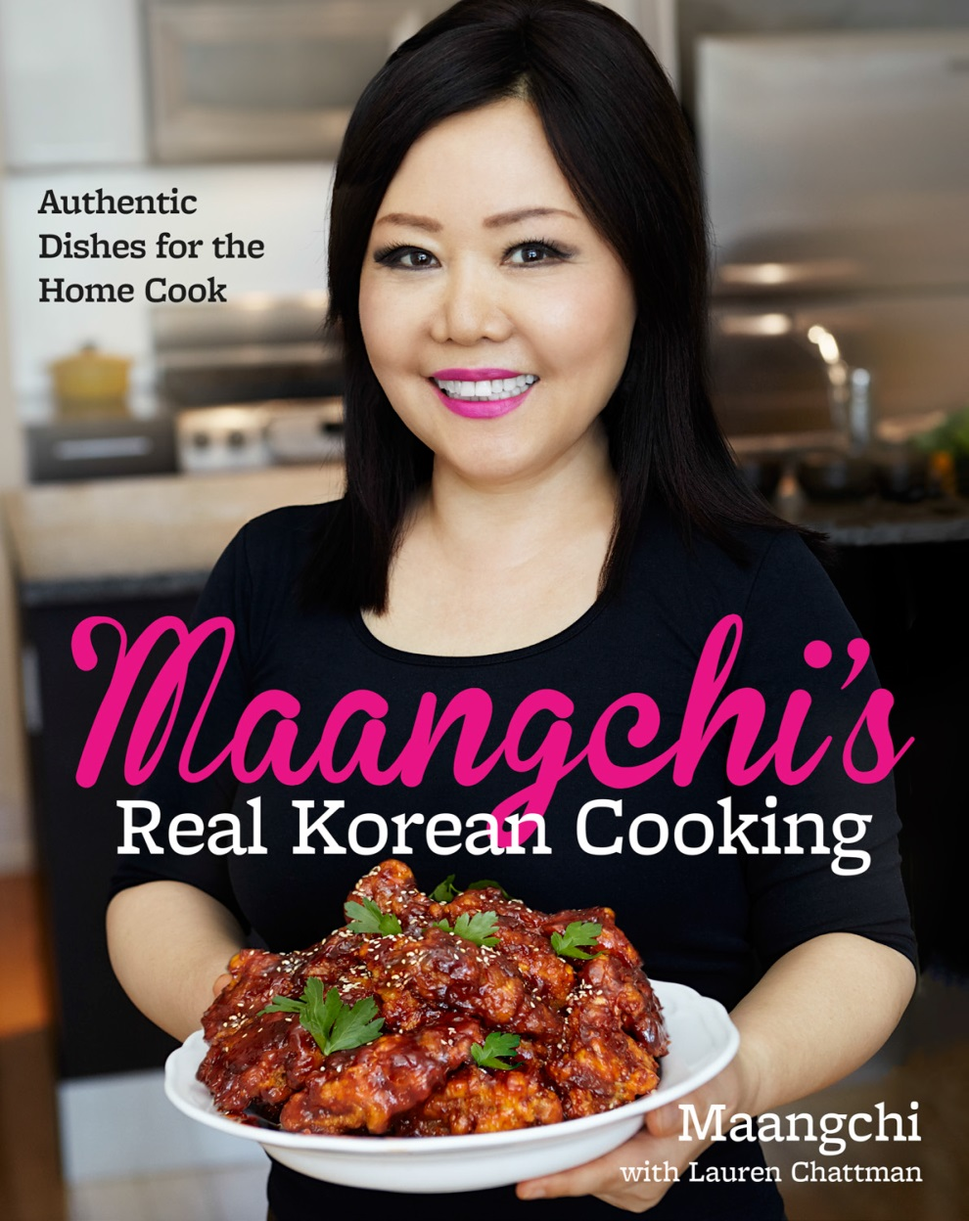
Maangchi
The Number 1 Youtuber of globalization about Korean food

Slide 2
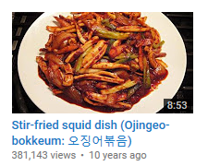
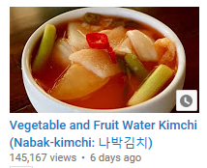
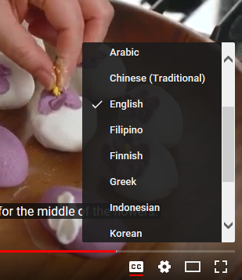
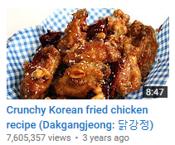
Here is a Korean food Youtuber with unusual records.
Having these records, she will probably be the only one.
Subtitles in
24 Languages
From 2007 to 2017
Top views
7.6 million

Slide 3
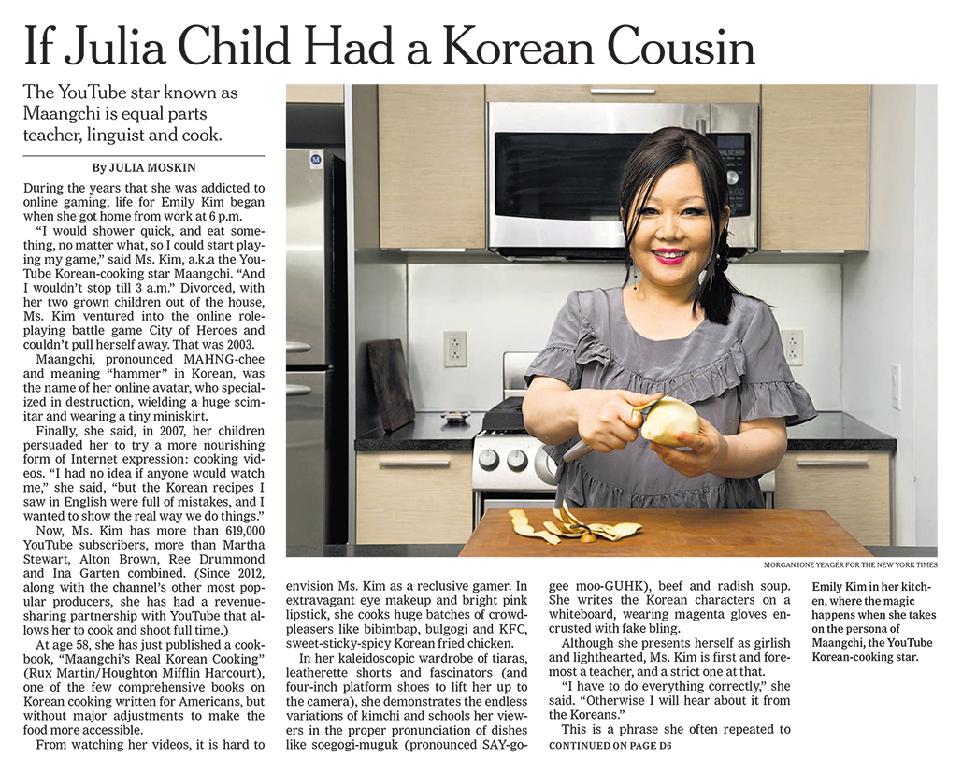
She also praised in various media.
Maangchi is more famous than Julia,
Who is an American well known for her living skills.

Slide 4
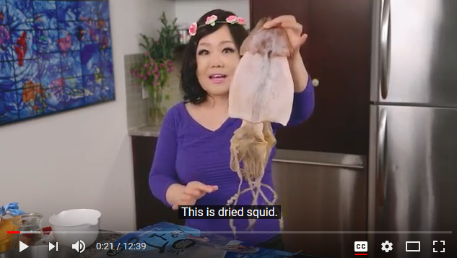
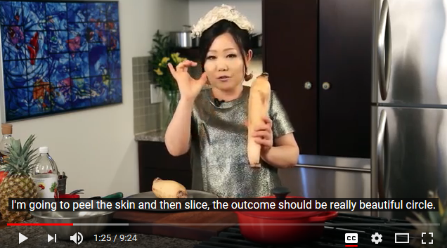
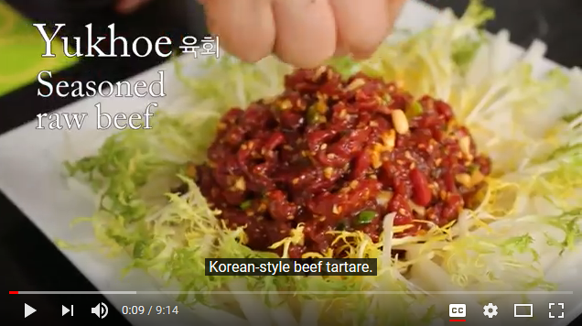
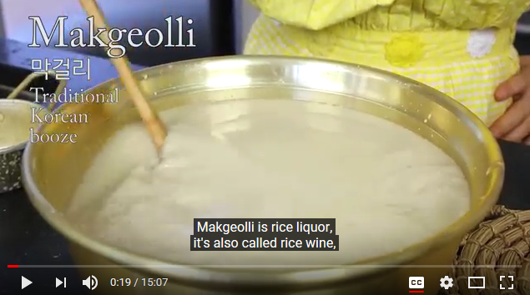
She also uses unfamiliar ingredients like dried squid and lotus root. In addition, there are many courses like Makgeolli and soy sauce, which have to be careful and take long time. Even if its difficulties, she always make the food wonderful.

Slide 5
What if Korean food became globalized in the way she loves Korean food?

Slide 6
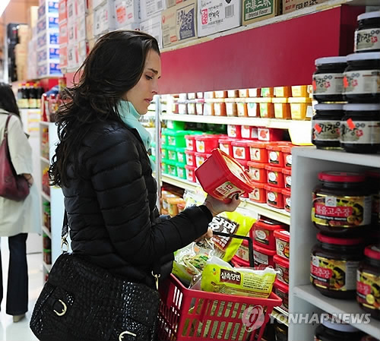
In May 2011, a Korean American actress, Brook Sills, in New York City, created a press release.
She is saying that she likes Korean but revealed that it is directed picture of her standing with an hot pepper paste, with a cost of 350 million won.

Slide 7
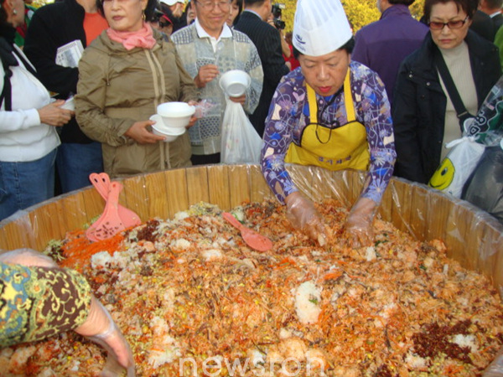
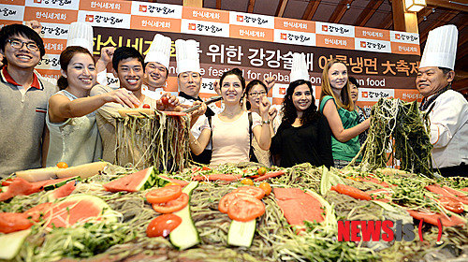
The Korean government 's globalization policy for Korean food has also been criticized by netizens for their unappetizing performance in various Korean food promotional festivals.

Slide 8
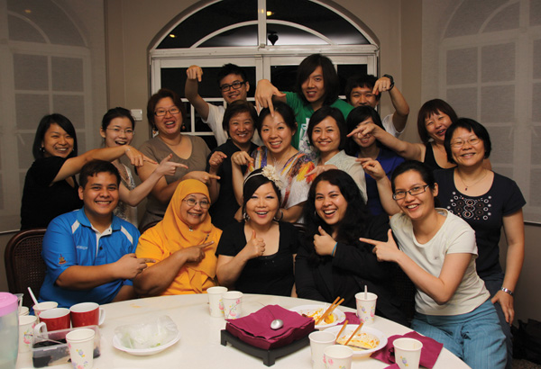
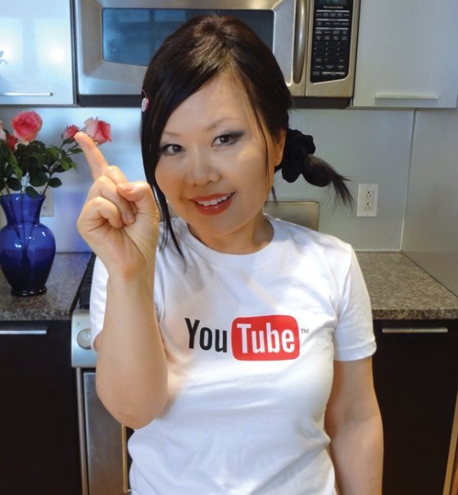
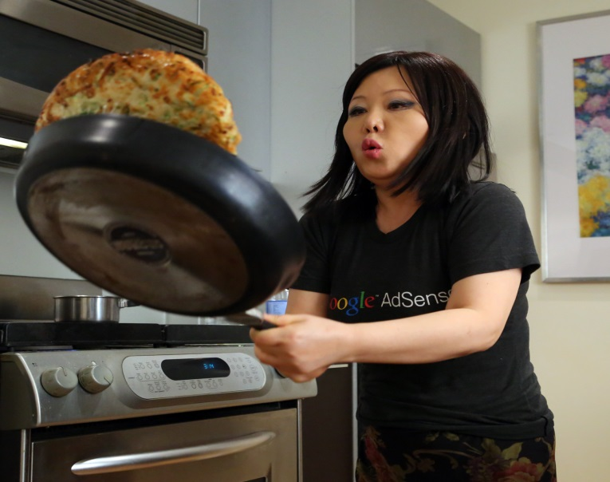
Rather than hastening and undermining the globalization of Korean food, if a person who ‘sincearely’ loves Korean food like Maangchi causes interest of foreigners and carefully informs the cooking methods, it will accelerate the globalization of Korean food.

Slide 9
Director: KIM SO YEON
Sources of contents
https://www.maangchi.com/wp-content/uploads/2009/06/maangchi-nyt-2015-06-03-e1.jpg
https://www.youtube.com/channel/UC8gFadPgK2r1ndqLI04Xvvw
http://www.pressian.com/news/article.html?no=120690
http://www.yonhapnews.co.kr/economy/2011/06/08/0301000000AKR20110608083400002.HTML
http://news.joins.com/article/12072506
http://www.newsroh.com/bbs/board.php?bo_table=focus&wr_id=84
http://kore.am/youtube-chef-maangchi-debuts-new-cookbook/
https://www.maangchi.com/blog/200k-youtube-subscribers

